Slide 1

Python Programming: An Introduction To Computer Science
Lecture 6 String operatıons
YUKSEL

Slide 2
Sequence of characters
We've talked about strings being a sequence of characters.
A string is indicated between ' ' or " "
The exact sequence of characters is maintained

Slide 3
And then there is """ """
triple quotes preserve both the vertical and horizontal formatting of the string
allows you to type tables, paragraphs, whatever and preserve the formatting
"""this is
a test
today"""

Slide 4
non-printing characters
If inserted directly, are preceded by a backslash (the \ character)
new line '\n'
tab '\t'

Slide 5
UTF-8
Every character is "mapped" (associated) with an integer
UTF-8, is such a mapping. Using 8 bit codes.
Notes:
Unicode Transformation Format

Slide 6
Subset of UTF-8
Notes:
Unicode Transformation Format

Slide 7
UTF-8
The function ord() takes a character and returns its UTF-8 integer value, chr() takes an integer and returns the UTF-8 character.
Notes:
Unicode Transformation Format

Slide 8
Strings
Can use single or double quotes:
S = "spam"
s = 'spam’s'
Just don't mix them
my_str = 'hi mom" ⇒ ERROR
Inserting an apostrophe?

Slide 9
Strings
Can use single or double quotes:
S = "spam"
s = 'spam'
Just don't mix them
my_str = 'hi mom" ⇒ ERROR
Inserting an apostrophe:
A = "knight's" # mix up the quotes

Slide 10
Strings
Can use single or double quotes:
S = "spam"
s = 'spam'
Just don't mix them
my_str = 'hi mom" ⇒ ERROR
Inserting an apostrophe:
A = "knight's" # mix up the quotes
B = 'knight\'s' # escape single quote

Slide 11
The Index
Because the elements of a string are a sequence, we can associate each element with an index, a location in the sequence:
positive values count up from the left, beginning with index 0
negative values count down from the right, starting with -1

Slide 13
Accessing an element
A particular element of the string is accessed by the index of the element surrounded by square brackets [ ]
hello_str = 'Hello World'
print(hello_str[1]) => prints e
print(hello_str[-1]) => prints d
print(hello_str[11]) => ?

Slide 14
Accessing an element
A particular element of the string is accessed by the index of the element surrounded by square brackets [ ]
hello_str = 'Hello World'
print(hello_str[1]) => prints e
print(hello_str[-1]) => prints d
print(hello_str[11]) => ERROR

Slide 15
Slicing, the rules
slicing is the ability to select a subsequence of the overall sequence
uses the syntax [start : finish], where:
start is the index of where we start the subsequence
finish is the index of one after where we end the subsequence
if either start or finish are not provided, it defaults to the beginning of the sequence for start and the end of the sequence for finish

Slide 16
half open range for slices
Slicing uses what is called a half-open range
The first index is included in the sequence
The last index is one after what is included

Slide 21


Slide 22
Extended Slicing
also takes three arguments:
[start:finish:countBy]
defaults are:
start is beginning, finish is end, countBy is 1
my_str = 'hello world'
my_str[0:11:2] ⇒ 'hlowrd'
every other letter

Slide 24
Some python idioms
Idioms are python “phrases” that are used for a common task. E.g.How to make a copy of a string:
my_str = 'hi mom'
new_str = my_str[:]
how to reverse a string
my_str = "madam I\'m adam"
reverseStr = ?

Slide 25
Some python idioms
Idioms are python “phrases” that are used for a common task. E.g.How to make a copy of a string:
my_str = 'hi mom'
new_str = my_str[:]
how to reverse a string
my_str = "madam I\'m adam"
reverseStr = my_str[::-1]

Slide 26
String Operations

Slide 28
Sequences are iterable objects
The for loop iterates through each element of a sequence in order. For a string, this means character by character:

Slide 29
Basic String Operations
s = 'spam'
length operator len()
len(s) ⇒ 4
+ is used to concatenate
new_str = 'spam' + '-' + 'spam-'
print(new_str) ⇒ spam-spam-
* is repeat, the number is how many times
new_str * 3 ⇒
'spam-spam-spam-spam-spam-spam-'

Slide 30
some details
both + and * on strings makes a new string, does not modify the arguments
order of operation is important for concatenation, irrelevant for repetition
the types required are specific. For concatenation you need two strings, for repetition a string and an integer

Slide 31
what does a + b mean?
what operation does the above represent? It depends on the types!
two strings, concatenation
two integers addition
the operator + is overloaded.
What does that mean?

Slide 32
what does a + b mean?
what operation does the above represent? It depends on the types!
two strings, concatenation
two integers addition
the operator + is overloaded.
The operation + performs depends on the types it is working on

Slide 33
The type function
You can check the type of the value associated with a variable using type
my_str = 'hello world'
type(my_str) ⇒ <type 'str'>
my_str = 245
type(my_str) ⇒ <type 'int'>

Slide 34
String comparisons, single char
Python 3 uses the Unicode mapping for characters.
Allows for representing non-English characters
UTF-8, subset of Unicode, takes the English letters, numbers and punctuation marks and maps them to an integer.
Single character comparisons are based on that number

Slide 35
comparisons within sequence
It makes sense to compare within a sequence (lower case, upper case, digits).
'a' < 'b' → True
'A' < 'B' → True
'1' < '9' → True
Can be weird outside of the sequence
'a' < 'A' → ?
'a' < '0' → ?

Slide 36
Subset of UTF-8
Notes:
Unicode Transformation Format

Slide 37
comparisons within sequence
It makes sense to compare within a sequence (lower case, upper case, digits).
'a' < 'b' → True
'A' < 'B' → True
'1' < '9' → True
Can be weird outside of the sequence
'a' < 'A' → False
'a' < '0' → False

Slide 38
Whole strings
Compare the first element of each string
if they are equal, move on to the next character in each
if they are not equal, the relationship between those to characters are the relationship between the string
if one ends up being shorter (but equal), the shorter is smaller

Slide 39
examples
'a' < 'b' → True
'aaab' < 'aaac'
first difference is at the last char. 'b'<'c' so 'aaab' is less than 'aaac'. True
'aa' < 'aaz'
?

Slide 40
examples
'a' < 'b' → True
'aaab' < 'aaac'
first difference is at the last char. 'b'<'c' so 'aaab' is less than 'aaac'. True
'aa' < 'aaz'
The first string is the same but shorter. Thus it is smaller. True

Slide 41
Membership operations
can check to see if a substring exists in the string, the in operator. Returns True or False
my_str = 'aabbccdd'
'a' in my_str ⇒ True
'abb' in my_str ⇒ True
'x' in my_str ⇒ False

Slide 42
Strings are immutable
strings are immutable, that is you cannot change one once you make it:
a_str = 'spam'
a_str[1] = 'l' → ERROR

Slide 43
Strings are immutable
strings are immutable, that is you cannot change one once you make it:
a_str = 'spam'
a_str[1] = 'l' → ERROR
However, you can use it to make another string (copy it, slice it, etc.)
new_str = a_str[:1] + 'l' + a_str[2:]
a_str → 'spam'
new_str →'slam'

Slide 44
String methods and functions

Slide 45
Functions, first cut
a function is a program that performs some operation. Its details are hidden (encapsulated), only it's interface provided.
A function takes some number of inputs (arguments) and returns a value based on the arguments and the function's operation.

Slide 46
String function: len
The len function takes as an argument a string and returns an integer, the length of a string.
my_str = 'Hello World'
len(my_str) ⇒ 11 # space counts!

Slide 47
String method
a method is a variation on a function
like a function, it represents a program
like a function, it has input arguments and an output
Unlike a function, it is applied in the context of a particular object.
This is indicated by the dot notation invocation

Slide 48
Example
upper is the name of a method. It generates a new string that has all upper case characters of the string it was called with.
my_str = 'Python Rules!'
my_str.upper() ⇒ 'PYTHON RULES!'
The upper() method was called in the context of my_str, indicated by the dot between them.

Slide 49
more dot notation
in general, dot notation looks like:
object.method(…)
It means that the object in front of the dot is calling a method that is associated with that object's type.
The method's that can be called are tied to the type of the object calling it. Each type has different methods.

Slide 50
Find
my_str = 'hello'
my_str.find('l') # find index of 'l' in my_str
⇒ 2
Note how the method 'find' operates on the string object my_str and the two are associated by using the “dot” notation: my_str.find('l').
Terminology: the thing(s) in parenthesis, i.e. the 'l' in this case, is called an argument.

Slide 51
Chaining methods
Methods can be chained together.
Perform first operation, yielding an object
Use the yielded object for the next method
my_str = 'Python Rules!'
my_str.upper() ⇒ 'PYTHON RULES!'
my_str.upper().find('O')
⇒ 4

Slide 52
Optional Arguments
Some methods have optional arguments:
if the user doesn't provide one of these, a default is assumed
find has a default second argument of 0, where the search begins
a_str = 'He had the bat'
a_str.find('t') ⇒ 7 # 1st 't',start at 0
a_str.find('t',8) ⇒ 13 # 2nd 't'

Slide 53
Optional Arguments
Some methods have optional arguments:
if the user doesn't provide one of these, a default is assumed
find has a default second argument of 0, where the search begins
a_str = 'He had the bat'
a_str.find('t') ⇒ 7 # 1st 't',start at 0
a_str.find('t',8) ⇒ 13 # 2nd ‘t’
#can you think of any alternate ways to find the second ‘t’?

Slide 54
Nesting Methods
You can “nest” methods, that is the result of one method as an argument to another
remember that parenthetical expressions are did “inside out”: do the inner parenthetical expression first, then the next, using the result as an argument
a_str.find('t', a_str.find('t')+1)
translation: find the second 't'.

Slide 55
How to know?
You can use Spyder to find available methods for any type. You enter a variable of the type, followed by the '.' (dot) and then a tab.
Remember, methods match with a type. Different types have different methods
If you type a method name, Spyder will remind you of the needed and optional arguments.
Ahmet’s Note: PyCharm is much better than Spyder.

Slide 56
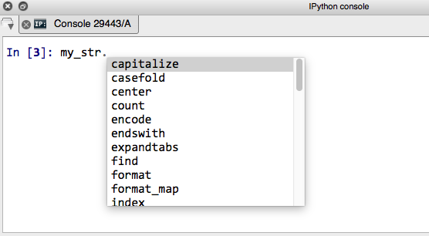

Slide 57
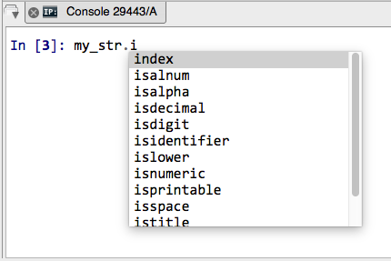

Slide 58
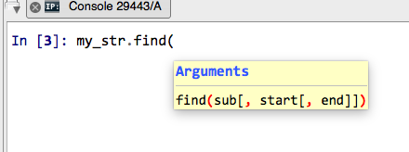

Slide 60
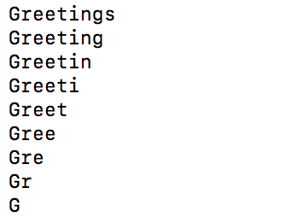
Sample Exam Question. What is the Python code for the output below?

Slide 61
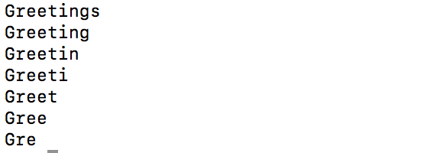
An Exercise
What if?

